Slide 1
ATAI
Advanced Technique of Artificial Intelligence
ATAI
ChongqingUniversity _{AdvancedTechniqueof}
of Technology Artificial Intelligence
Chongqing University of
Technology
Chongqing University ^{ATAI}
_{of Technology} Advanced Techniqueof
Artificial Intelligence
Chongqing University of Technology
Chongqing University of Technology
GENIUS: AGenerative Framework for Universal Multimodal Search
Code:None
——CVPR_2025
Reported by Jinfei Chen
1

Slide 2
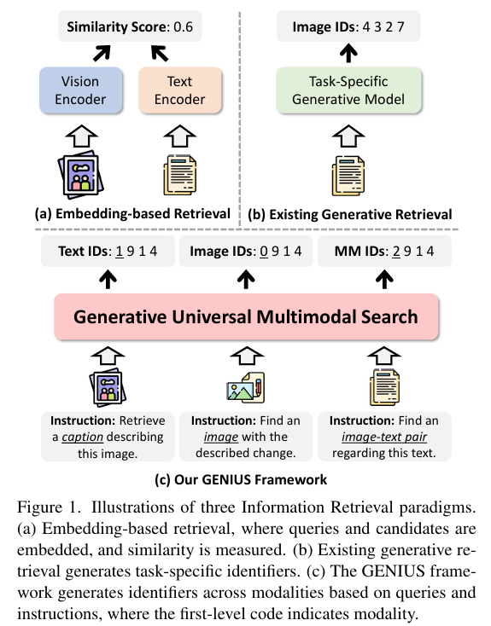
ATAI
Advanced Technique of Artificial Intelligence
ATAI
ChongqingUniversity _{AdvancedTechniqueof}
of Technology Artificial Intelligence
Chongqing University of
Technology
Chongqing University ^{ATAI}
_{of Technology} Advanced Techniqueof
Artificial Intelligence
Chongqing University of Technology
Chongqing University of Technology
Motivation
However, existing models are task-specific and fall short of embedding-based retrieval in performance.
Most of them are dedicated to text retrieval, and only a few recent works address images and cross-modal retrieval
Notes:
这种方法通过从查询直接生成目标数据的标识符（ID），绕过了传统的最近邻搜索。然而，这些方法通常是为特定任务设计的，因此能力有限。
目前大多数方法专注于文本检索 [50, 52]，仅有少数工作涉及图像 [60] 和跨模态检索 [26]
因此，这些方法难以满足现实应用中用户对多样化、多模态检索的需求。
而且，在跨模态检索中，现有的生成式方法相比于基于嵌入的方法表现仍然较差 [26, 60]。

Slide 3
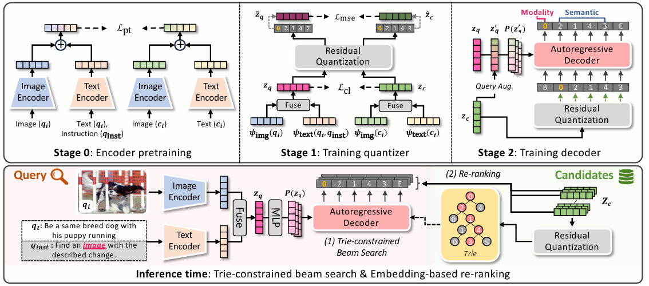
ATAI
ChongqingUniversity _{AdvancedTechniqueof}
of Technology Artificial Intelligence
Chongqing University of
Technology
ATAI
Advanced Technique of Artificial Intelligence
Chongqing University ^{ATAI}
_{of Technology} Advanced Techniqueof
Artificial Intelligence
Chongqing University of Technology
Chongqing University of Technology
Overview
Notes:
使用 Beam Search，它会探索多个可能的 ID 序列，并根据每一层的对数概率之和进行排序。
问题：普通的 Beam Search 可能会生成无效的 ID，即在真实测试集中不存在的目标标识符。
我们引入了 受限 Beam Search，结合使用了 Trie（字典树）结构 ，用于限制解码器只能生成合法的前缀，确保每一个输出的 ID 都是候选集中存在的有效 ID。
---
尽管生成式方法在效率上具有明显优势，但由于 离散 ID 的表达能力有限，其性能仍然可能低于传统的基于嵌入的检索方法
为解决这一问题，我们引入了一个 重排序机制：
使用 Beam Search 预测出 B 个候选 ID；
计算这些候选目标与查询之间的嵌入相似度（例如：余弦相似度）；
基于相似度对结果重新排序。

Slide 4
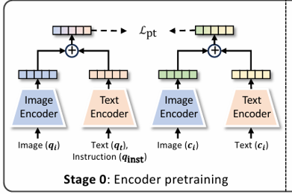
ATAI
Advanced Technique of Artificial Intelligence
ATAI
ChongqingUniversity _{AdvancedTechniqueof}
of Technology Artificial Intelligence
Chongqing University of
Technology
Chongqing University ^{ATAI}
_{of Technology} Advanced Techniqueof
Artificial Intelligence
Chongqing University of Technology
Chongqing University of Technology
Method

Slide 5
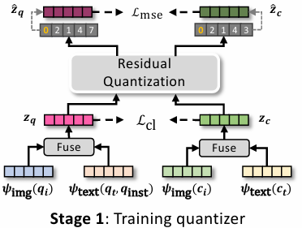
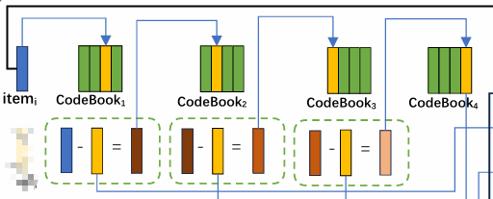
ATAI
Advanced Technique of Artificial Intelligence
ATAI
ChongqingUniversity _{AdvancedTechniqueof}
of Technology Artificial Intelligence
Chongqing University of
Technology
Chongqing University ^{ATAI}
_{of Technology} Advanced Techniqueof
Artificial Intelligence
Chongqing University of Technology
Chongqing University of Technology
Method
Notes:
利用残差量化的固有特性 —— 每一层的码本嵌入表示的是该层特有的“残差信息”。这种逐层量化的机制支持了信息的逐步分离（progressive separation）。
我们正是利用这一特性，实现了模态信息与语义信息的分层编码：

Slide 6
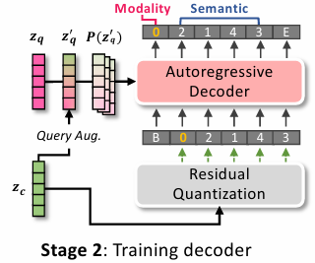
ATAI
Advanced Technique of Artificial Intelligence
ATAI
ChongqingUniversity _{AdvancedTechniqueof}
of Technology Artificial Intelligence
Chongqing University of
Technology
Chongqing University ^{ATAI}
_{of Technology} Advanced Techniqueof
Artificial Intelligence
Chongqing University of Technology
Chongqing University of Technology
Method
Notes:
由于离散 ID 的表示能力相较于连续嵌入较弱，模型在泛化能力上可能存在不足，特别是在训练数据中的查询-目标对数量较少时更为明显
基于查询-目标插值的查询增强策略，然后使用与原始训练相同的交叉熵损失对解码器进行训练

Slide 7
ATAI
Advanced Technique of Artificial Intelligence
ATAI
ChongqingUniversity _{AdvancedTechniqueof}
of Technology Artificial Intelligence
Chongqing University of
Technology
Chongqing University ^{ATAI}
_{of Technology} Advanced Techniqueof
Artificial Intelligence
Chongqing University of Technology
Chongqing University of Technology
Experiments

Slide 8
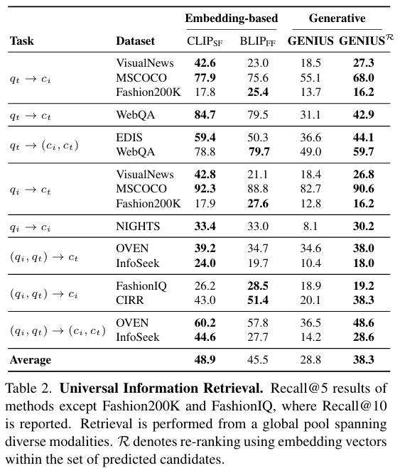
ATAI
Advanced Technique of Artificial Intelligence
ATAI
ChongqingUniversity _{AdvancedTechniqueof}
of Technology Artificial Intelligence
Chongqing University of
Technology
Chongqing University ^{ATAI}
_{of Technology} Advanced Techniqueof
Artificial Intelligence
Chongqing University of Technology
Chongqing University of Technology
Experiments

Slide 9
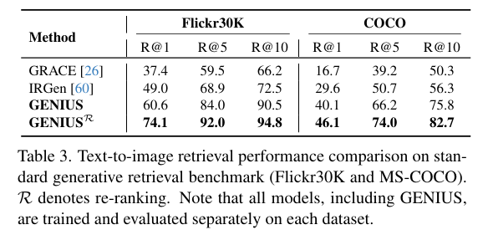
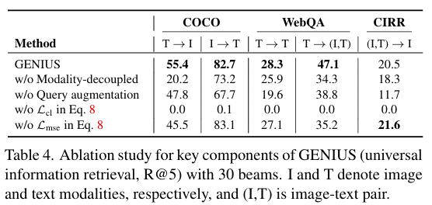
ATAI
Advanced Technique of Artificial Intelligence
ATAI
ChongqingUniversity _{AdvancedTechniqueof}
of Technology Artificial Intelligence
Chongqing University of
Technology
Chongqing University ^{ATAI}
_{of Technology} Advanced Techniqueof
Artificial Intelligence
Chongqing University of Technology
Chongqing University of Technology
Experiments

Slide 10
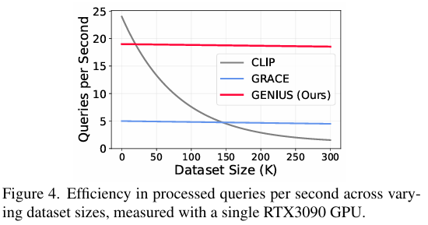
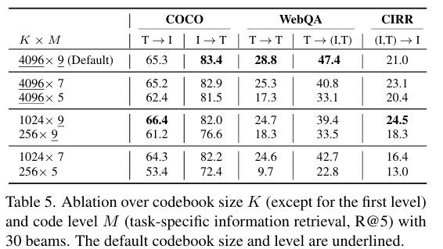
ATAI
Advanced Technique of Artificial Intelligence
ATAI
ChongqingUniversity _{AdvancedTechniqueof}
of Technology Artificial Intelligence
Chongqing University of
Technology
Chongqing University ^{ATAI}
_{of Technology} Advanced Techniqueof
Artificial Intelligence
Chongqing University of Technology
Chongqing University of Technology
Experiments

Slide 11
ATAI
Advanced Technique of Artificial Intelligence
ATAI
ChongqingUniversity _{AdvancedTechniqueof}
of Technology Artificial Intelligence
Chongqing University of
Technology
Chongqing University ^{ATAI}
_{of Technology} Advanced Techniqueof
Artificial Intelligence
Chongqing University of Technology
Chongqing University of Technology
Thanks!

